Slide 1
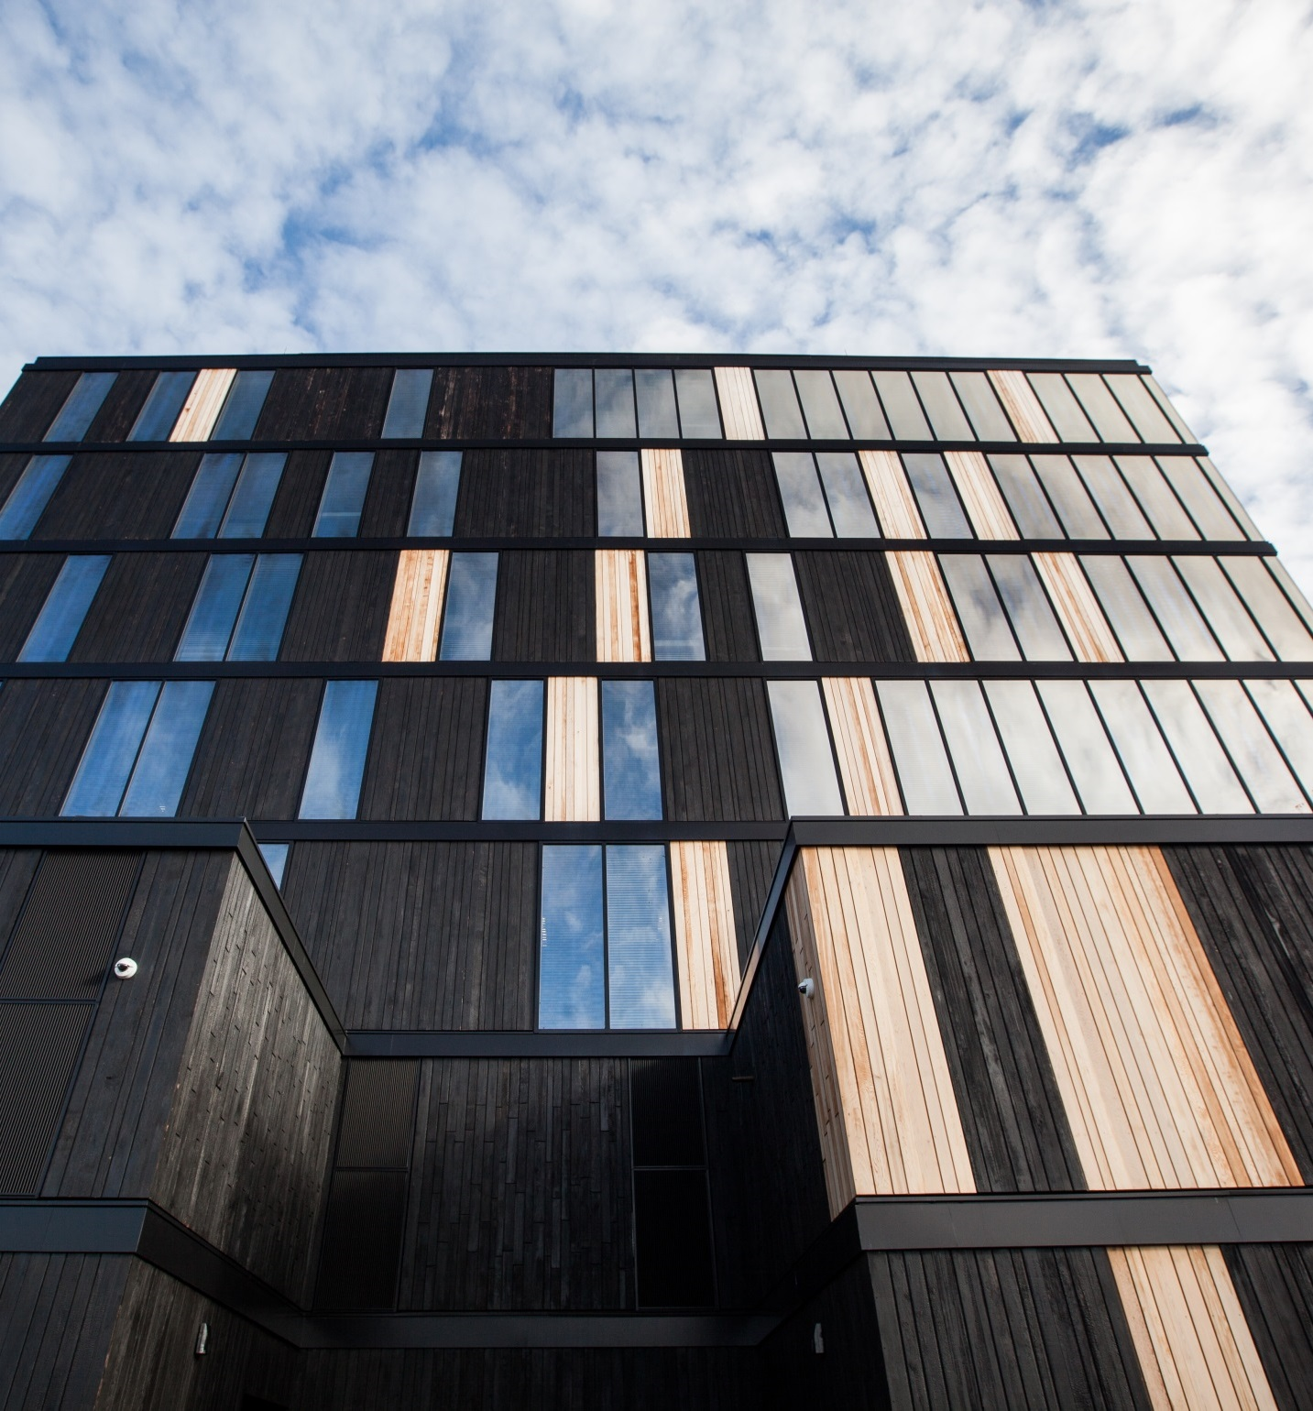
Tall Wood Takes a Stand
Photo courtesy of naturally:wood
Tall wood buildings proven safe and cost effective
Earn 1 AIA/CES HSW learning unit (LU)
CEU Publish Date: December 2014
Notes:
1.

Slide 2
Best Practices
reThink Wood sponsors this Continuing Education Unit provided by McGraw-Hill Publishers. This course is registered with AIA CES for continuing professional education.
As such, it does not contain content that may be deeded or construed to be an approval or endorsement by the AIA of any materials of constructions or any manner of handling, using, distributing, or dealing in any material or product.
Credit earned on completion of this course will be reported to AIA CES for AIA members. Certificates of completion are available for self-reporting and record-keeping needs.
Questions related to the information presented should be directed to reThink Wood upon completing this program. Please contact info@reThinkWood.com.
AIA Provider Number: K029
AIA/CES Course number: K1412K
AIA Credit: 1 AIA/CES HSW learning unit (LU)
Notes:
2.

Slide 3
Copyright Materials
This presentation is protected by U.S. and international copyright laws. Reproduction, distribution, display and use of the presentation without written permission of reThink Wood is prohibited.
© 2015, reThink Wood, reThinkWood.com
Notes:
3.

Slide 4
Learning Objectives
Recognize that mid-rise (six to 12 stories) and tall buildings (up to 30 stories) can be safely, efficiently, and economically built using mass timber construction techniques.
Discuss the different types of design approaches to mass timber construction for tall wood buildings.
Explain the similarities and differences between the structural composite panel and lumber products that allow building professionals to design and construct tall wood buildings.
Distinguish the differences between design approaches to accessing the acceptable structural passive fire protection measures in a mass timber building.
Notes:
4.

Slide 5
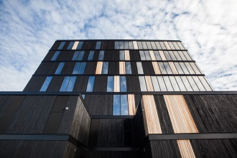
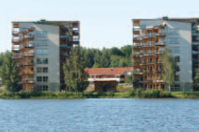
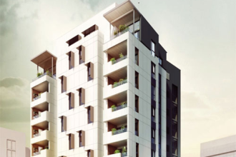
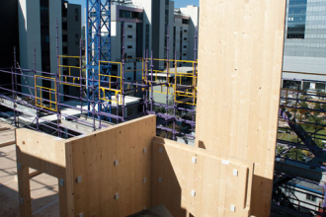
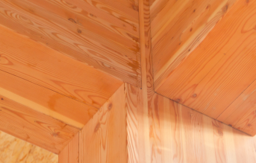
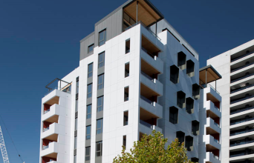
Table of Contents
Section 1
The Inspiration Behind Tall Wood Buildings
Section 2
Safety and Performance
Section 3
Tall Wood Around the World: Lessons Learned
Section 4
Responsible Revolution
Section 5
Appendix | Common Mass Timber Products
Section 6
Endnotes
Notes:
5.
TABLE OF CONTENTS
The Inspiration Behind Tall Wood
Safety and Performance
Tall Wood Around the World: Lessons Learned
Responsible Revolution
Appendix | Common Mass Timber Products
Endnotes

Slide 6
THE INSPIRATION BEHIND TALL WOOD
SECTION 1
Notes:
6.
SECTION 1: The Inspiration Behind Tall Wood
The Case for Tall Wood Buildings
Survey of International Tall Wood Buildings
Environmental benefits
Environmental inspiration: Forté
Cost competitive

Slide 7
Why Wood?
Cost-effective, easy to source locally
Strong, lightweight and versatile
Sustainable, natural, renewable resource
Wood manufacturing requires less energy and has lower greenhouse gas emissions than manufacturing of other materials
Energy efficient
Safe and reliable, with proven performance
Wood products continue to store carbon absorbed by the tree while growing
Photo: naturallywood.com
Notes:
7.
Wood is …
Strong, lightweight, and versatile
Sustainable, natural, recyclable, renewable
Carbon efficient, since it sequesters carbon and reduces greenhouse gases in the atmosphere
Cost effective and abundant—easy to source locally
Reliable, providing proven performance for seismic, wind, and other loading conditions
Energy efficient, with lower thermal conductivity
Warm, visually appealing, and inviting

Slide 8
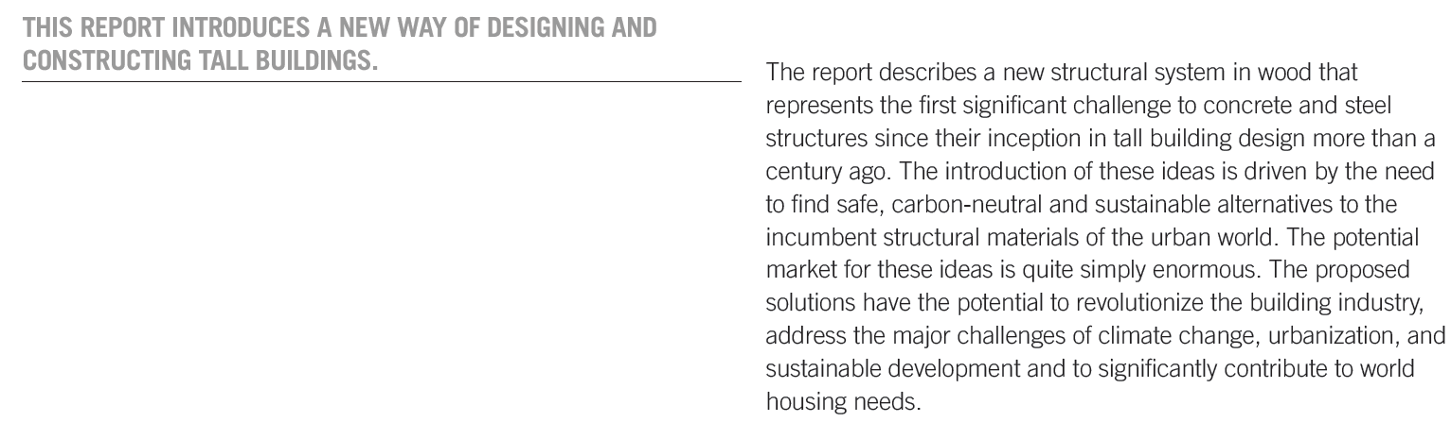
The Case for Tall Wood Buildings
How Mass Timber Offers a Safe, Economical, and Environmentally Friendly Alternative for Tall Building Structures
Study by Architect Michael Green of mgb and J. Eric Karsh from Equilibrium Consulting Inc.
Notes:
8.
In 2012, The Case for Tall Wood Buildings outlined a compelling argument for building taller wood structures, showing that midrise (six to 12 stories) and tall buildings (up to 30 stories) could be safely, efficiently, and economically built using mass timber construction techniques. (http://cwc.ca/wp-content/uploads/publications-Tall-Wood.pdf)

Slide 9
Survey of International Tall Wood Buildings
Completed tall wood projects have demonstrated successful applications of mass timber technologies.
Inspired by…
Innovation
Market leadership
Carbon reduction
Photo courtesy of Riccardo Ronchi
Notes:
9.
The 2014 Survey of International Tall Wood Buildings demonstrates how tall wood building techniques have been successfully used in “tall wood” projects worldwide. Design approaches range from conventional platform-based systems made from cross laminated timber (CLT) to glued-laminated (glulam) timber framing to composite wood-concrete and wood-steel building systems.
The survey found that designers pushing boundaries with taller wood buildings are doing so because of innovation, market leadership, and carbon reduction. Energy efficiency and healthy indoor environments that promote a sense of well-being were found to be complementary objectives.

Slide 10
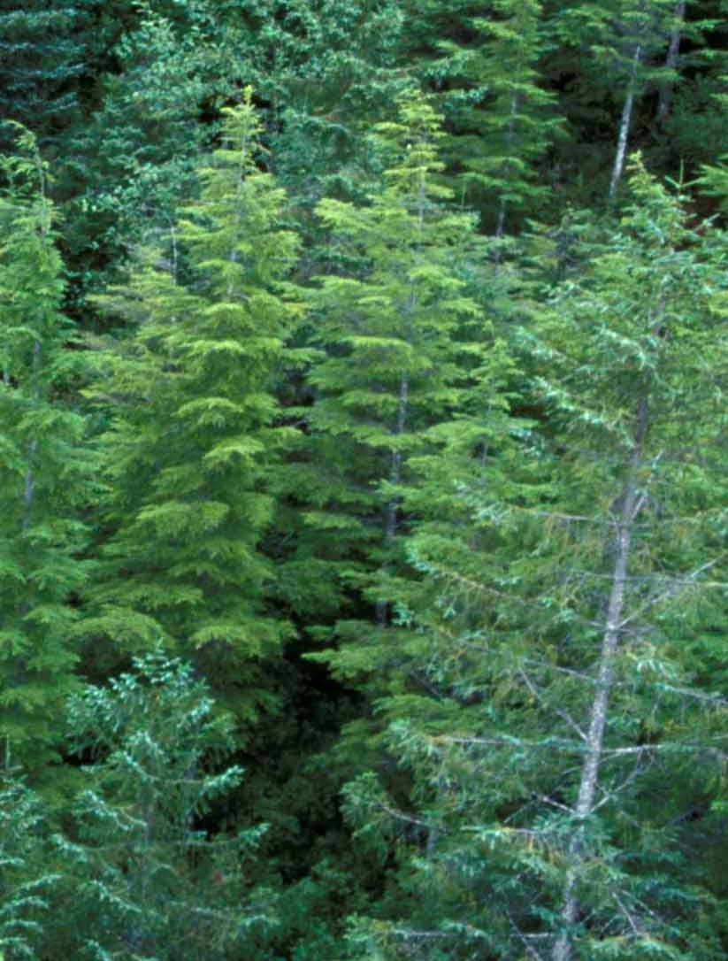
Environmental Benefits
Wood grows naturally and is renewable
Stores carbon
Requires less energy to manufacture
Lower greenhouse gas emissions
Photo courtesy naturallywood.com.
Notes:
10.
From an environmental perspective, wood grows naturally and is renewable. Its carbon benefits derive from the fact that wood products continue to store carbon absorbed by the trees while growing, and wood manufacturing requires less energy and results in less greenhouse gas emissions than the manufacturing of other materials. Life cycle assessment studies consistently show that wood outperforms other materials in terms of embodied energy, air and water pollution, and global warming potential.

Slide 11
Cost Competitive
Cost competitive up to 30 stories
Versatile building systems and installation methodologies
Configuration choices offer flexibility
Quick installation, faster occupancy
Notes:
11.
The IBC allows five stories of wood-frame construction (plus a wood mezzanine) for most occupancy types, including multi-residential, and six stories for business. These buildings, which utilize dimension lumber and structural wood panels as well as engineered lumber components, have proven themselves to be cost-effective alternatives to light-gauge steel and concrete.
From a cost perspective, mass timber products cannot compete with light wood frame construction for most low- and mid-rise projects. Rather, engineered for strength and dimensional stability, mass timber offers an alternative to steel and concrete where light wood framing may not be applicable.
For example, the U.S. CLT Handbook says that CLT becomes more cost competitive at higher building heights or sizes, indicating that mass timber products may be an attractive choice for mid-rise, industrial, retail (one to two stories), and educational (two to three stories) buildings.
Adding to their cost advantage, mass timber structures can generally be erected much more quickly than structures made from other materials.
Development company Lend Lease estimates that the $11-million Forté apartment building in Melbourne, Australia was built 30 percent faster because the materials were prefabricated.

Slide 12
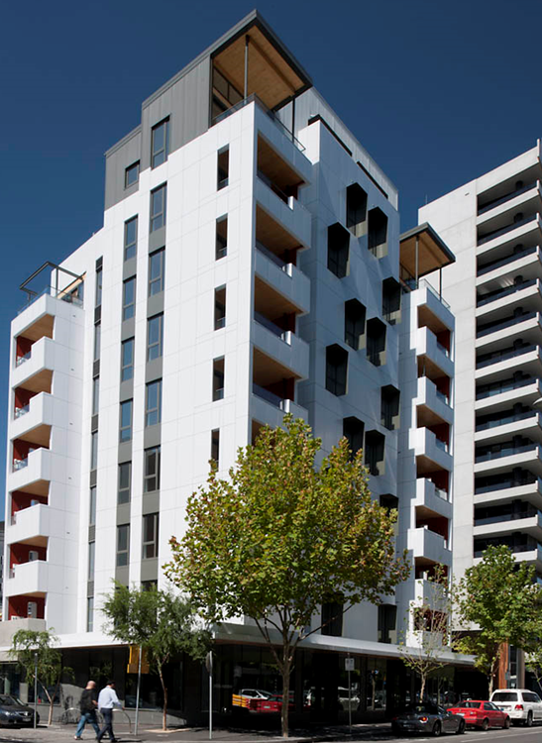
KEY PROJECT
Environmental Inspiration
Ten-story Forté is Australia’s first CLT building and first high-rise timber apartment. The developer cites environmental benefits as the primary reason for using wood.
Forté
Melbourne, Australia
Architect/Contractor/Developer: Lend Lease
Completed: 2012
Photo courtesy of Lend Lease
Notes:
12.
Rising 10 stories, Forté is Australia’s first CLT building and first high-rise timber apartment. At its time of completion, it was the tallest timber apartment in the world. The developer and contractor, Lend Lease, used a conventional platform-based CLT system to build the $11-million project, which includes 23 apartments and four townhouses. Speed of construction was a huge benefit to the global company; Lend Lease estimated that they cut construction time by 30 percent. Construction began in February 2012; they began installing the CLT in May and completed the wood portion of the structure in August. While they chose CLT in part because it met safety and quality requirements, Lend Lease cites the environmental benefits as their primary reason for building the tall building out of wood. Forté was expected to be the first 5 Star Green-Star As Built-certified residential building in Australia. And by using CLT, the structure will reduce CO2 equivalent emissions by more than 1,400 tons when compared to concrete and steel—the equivalent of removing 345 cars from Melbourne’s roads for a year.
Lend Lease reported that costs to build Forté with CLT were comparable with that of using concrete. Going forward, they said they plan to develop 30 to 50 percent of their Australian apartment projects using CLT.

Slide 13
SAFETY AND PERFORMANCE
SECTION 2
Notes:
13.
SECTION 2: Safety and Performance
Structural performance: Treet
Tall Wood fire safety
CLT fire testing results
Structural/seismic performance
Shake table testing
Thermal performance
Acoustical performance
Building height considerations
Eight stories of wood: Bridport House
Code approvals
Innovative construction: Wood Innovation and Design Centre

Slide 14
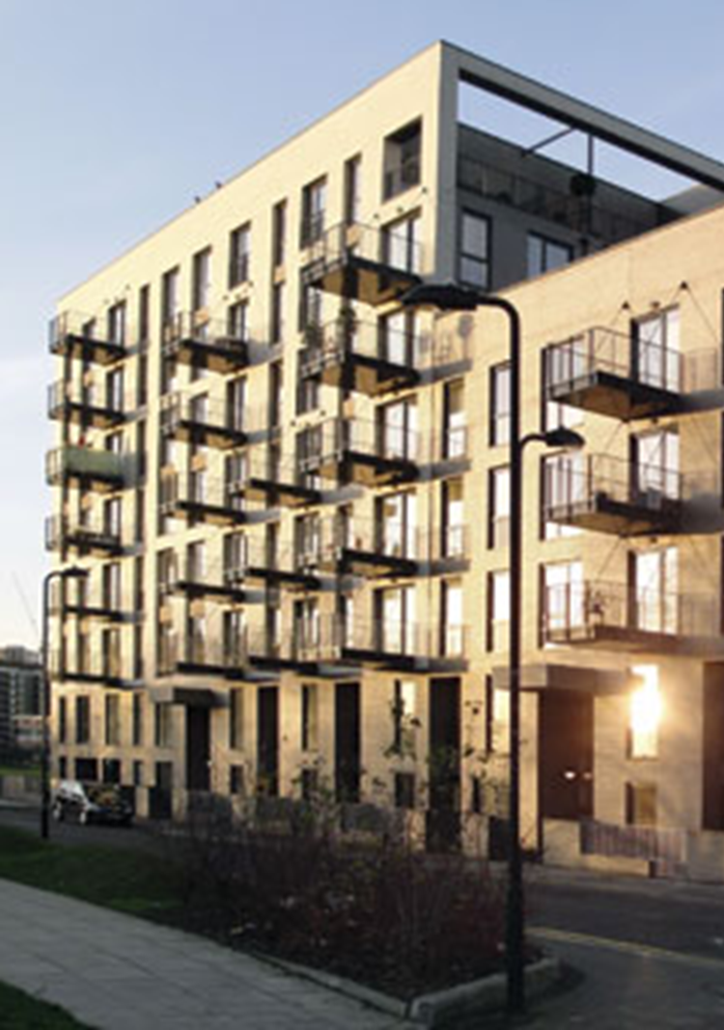
Tall Wood Fire Safety
Design approaches for structural passive fire protection:
Encapsulation
Charring
Mass timber systems also limit combustible concealed spaces, reducing fire’s ability to spread undetected.
Photo courtesy of Karakusevic Carson Architects
Notes:
14.
Research shows mass timber buildings behave very well in fire. There are two design approaches to achieving the acceptable structural passive fire protection measures in a mass timber building.
Encapsulation is used to provide fire-resistance rating to timber structures. Designers can apply one or two layers (depending on the fire assembly required by code) of fire-rated gypsum board to the underside of floors and throughout the building to reach the desired protection level. This method is similar to standard construction techniques used to construct fire-rated floor, roof, and wall assemblies in both combustible and noncombustible building types.
Charring is increasingly accepted around the world as a valid means of realizing reliable and safe structural performance in fire. The solid wood members used in mass timber construction allow a char layer to form during a fire situation. This, in turn, helps insulate the remaining wood from heat penetration. By combining modern fire suppression systems and compartmentalization, structures can be detailed to safely resist fire without encapsulation, using charring calculation methods. This eliminates the need for the gypsum board, reducing building weight and cost while showcasing the natural beauty of the exposed wood.

Slide 15
CLT Fire Testing Results
American Wood Council test on a load-bearing five-ply CLT wall
Test specimen lasted three hours, five minutes & 57 seconds
Well beyond the two-hour goal
Notes:
15.
In 2012, the American Wood Council (AWC) conducted a successful fire resistance test on a load-bearing CLT wall. The test, conducted in accordance with AST M E-119-11a (Standard Test Methods for Fire Tests of Building Construction and Materials), evaluated CLT’s fire-resistance properties. The CLT test specimen lasted three hours, five minutes, and 57 seconds (03:05:57)—well beyond the two-hour goal.

Slide 16
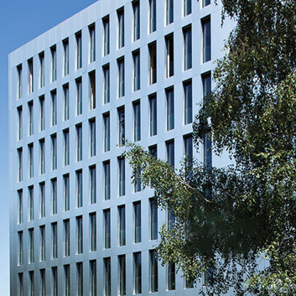
Structural/Seismic Performance
Wood matches or exceeds strength-to-weight ratio of reinforced concrete
Lower weight places less load on structure and foundation, reducing foundation costs
Dimensional stability creates effective lateral load-resisting system
Photo courtesy of Cree Buildings Inc.
Notes:
16.
Engineered wood products generally match and, in some cases, exceed the performance of reinforced concrete in strength-to-weight ratio. In addition, timber’s weight is just 25 percent of reinforced concrete, placing less gravity and seismic loads on the structure and foundation. Mass timber building components are dimensionally stable and rigid, creating an effective lateral load-resisting system.

Slide 17
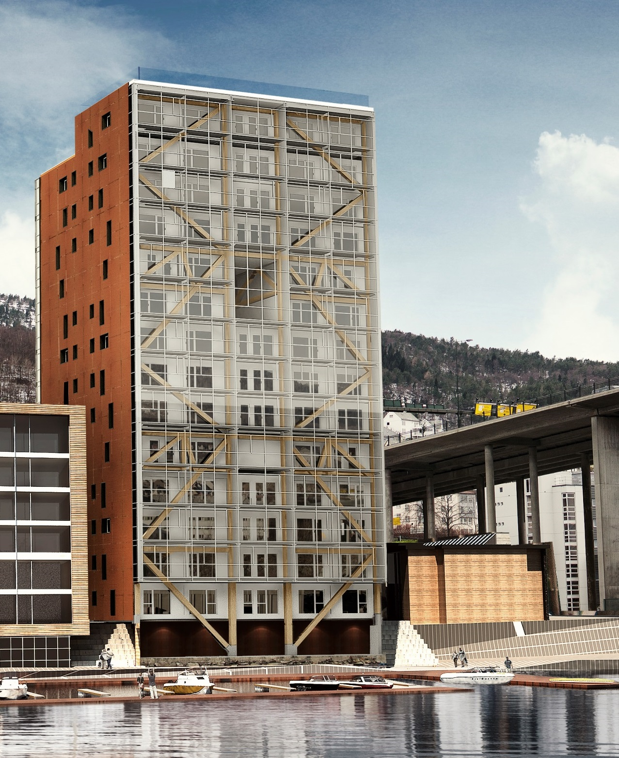
KEY PROJECT
Structural Performance
Treet, a 14-story timber-frame project in Norway, is scheduled for occupancy in the fall of 2015.
Treet (The Tree)
Bergen, Norway
Architect: Artec
Completed: 2015
Photo courtesy of Sweco/Artec/3Seksti
Notes:
17.
This luxury apartment building consists primarily of load-carrying glulam trusses and prefabricated building modules made from traditional timber framing. To address potential wind load issues, structural engineers increased mass by adding concrete decks on floors 5 and 10, and on the roof.
While glulam trusses provide stiffness, the lightness of the wood building meant that it would move more than was acceptable in high winds. By adding mass, the total system restricts accelerations to a maximum of 0.04 m/s2, which is in compliance with the comfort criteria given by the ISO standard.
While the interior walls, corridors, elevator shaft and balconies are CLT, CLT is not part of the main load-bearing system. The building will be clad in glass and metal sheeting.
According to the project owner, the Bergen and Omegn Building Society, the wood products used in Treet will store approximately 1,000 metric tons of CO2.

Slide 18
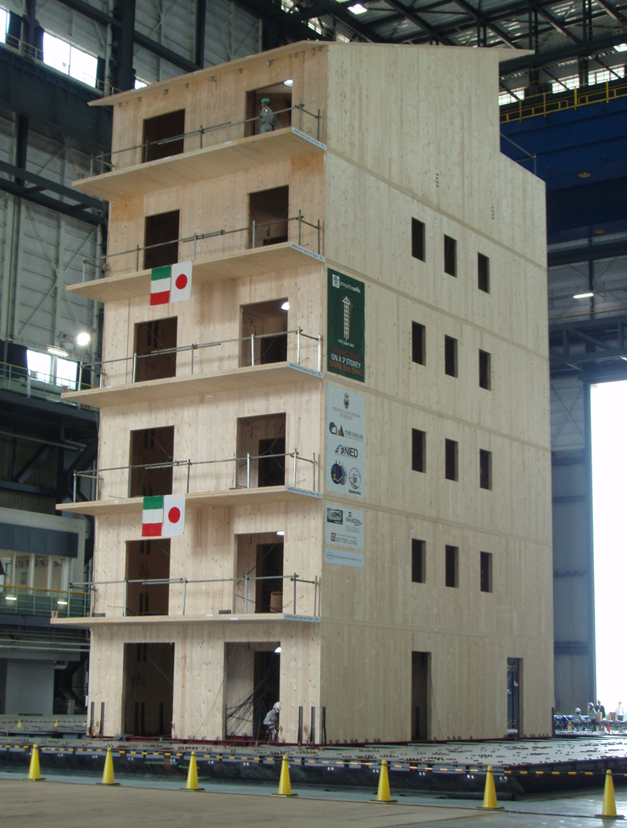
Shake Table Test – Seven Story Wood Building
Researchers tested seven-story CLT building
14 consecutive seismic events
Building suffered only isolated and minimal structural damage
“Based on full-scale seismic testing, it appears that CLT structures may offer more disaster resilience than those building with other heavy construction materials.”
U.S. CLT Handbook
Photo courtesy of IVALSA
Notes:
18.
Researchers tested a seven-story CLT building on the world’s largest shake table in Miki, Japan. Even after 14 consecutive seismic events, the building suffered only isolated and minimal structural damage.
Assuming an actual building performs the same as the test building, the rehabilitation and repair required following an earthquake would also be minimal.

Slide 19
Thermal Performance
Like all wood products, mass timber offers excellent thermal performance:
Thicker panels are better insulators
Precise component tolerances reduce gaps
Notes:
19.
Like all wood products, mass timber offers excellent thermal performance. Wood’s thermal properties are determined by U-value, or coefficient of heat transfer, which relates to panel thickness. Thicker panels have lower U-values; they are better insulators and therefore require less insulation. The way in which mass timber buildings are constructed also improves its thermal performance. CLT, LVL and LSL can be manufactured using computer numerical control (CNC) equipment to precise tolerances, so panel joints fit tightly, which can improve energy efficiency.

Slide 20
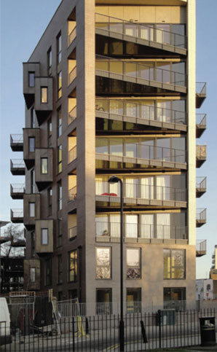
Acoustic Performance
Mass of the wall contributes to acoustic performance
Sealants and or caulking provide additional acoustic benefits
Avoid rigid contact between building elements to reduce vibrational energy
Mass timber building systems provide appropriate noise control for both airborne and impact sound transmission.
Photo courtesy of Karakusevic Carson Architects
Notes:
20.
Because the mass of a wall contributes to its acoustic performance, mass timber building systems provide appropriate noise control for both airborne and impact sound transmission, often without the need to add additional acoustical layers. However, as noted in the U.S. CLT Handbook, a large part of achieving acceptable acoustic performance is simply giving adequate attention to details in the design and construction of the project.

Slide 21
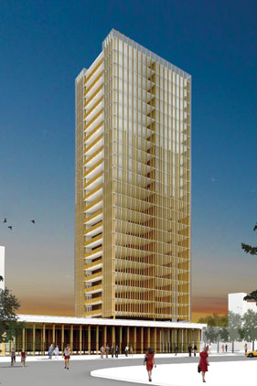
Building Height Considerations
Mass timber buildings have minimal shrinkage over time
Continuous rod tie-down systems limit lateral deflection
Expansion joints allow for movement
Platform-based CLT construction can have slightly more accumulative shrinkage over the height of the building than those using LVL or LSL components.
Rendering courtesy of mgb
Notes:
21.
Because they use engineered wood products, mass timber buildings have minimal shrinkage over time because the moisture content of the wood used in engineered wood is typically just 8 to 10 percent. Therefore, mass timber products experience little shrinkage along the main axis of the material during the life of a building. Slightly more shrinkage can be found across the thickness of CLT material than with LSL or LVL due to CLT’s solid wood composition. Therefore, platform-based CLT construction (which includes CLT floors and walls) can result in slightly more accumulative shrinkage over the height of the building than systems that rely more heavily on LVL or LSL, requiring additional consideration in the detailing of the exterior envelope.

Slide 22
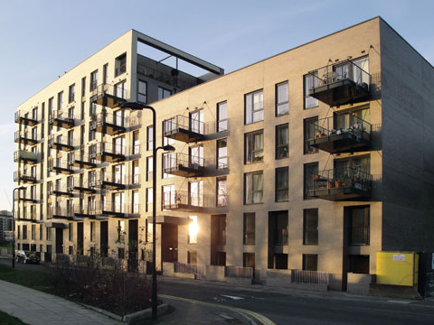
KEY PROJECT Eight Stories of Wood
Bridport House
Hackney (London), UK
Architect: Karakusevic Carson Architects
Completed: 2011
Developers used wood for Bridport House for several reasons: structural capabilities of CLT, speed of construction and environmental advantages.
Photo courtesy of Karakusevic Carson Architects
Notes:
22.
When it was completed in 2011, this eight-story structure formed the largest timber-built apartment block in the world. Built using a conventional platform-based CLT system, the structure included 41 new homes in two joined blocks; one eight-story building and the other five stories. All elements from the ground floor up were of CLT, including the elevator shaft. As is typical of these buildings, the below-ground level was of reinforced concrete but the ground floor was CLT. The project was built over an old sewer line that runs through London; the line is big enough to drive a double-decker bus through but could not sustain the loads of a heavy concrete building above. Wood’s light weight allowed the developer to maximize use of the site while still meeting below-ground requirements. In fact, the structure was twice as high as the previous building, while the weight increased by only 10 percent. On-site assembly took just 12 weeks, primarily because the CLT panels were prefabricated off-site and then lifted into place. EURBAN, the project’s timber engineer, estimates that on-site assembly time was 50 percent faster than conventional reinforced concrete. The environmental benefits of using wood for Bridport are also noteworthy. If the building had been constructed of reinforced concrete, manufacturing of the materials would have resulted in an additional 892 tons of carbon into the atmosphere; that’s equivalent to 12 years of the operational energy required to heat and light all the dwellings at Bridport House. When the carbon stored in the timber structure is added to the avoided greenhouse gas emissions, the total carbon benefit is 2,113 tons—equivalent to 29 years of operational energy. Plus, because of the thermal benefits afforded by a CLT building system, the structure’s airtightness measured three times better than that required by local building regulations.

Slide 23
Code Approvals
Current IBC allows wood-frame construction for five stories for most building occupancies
U.S. and Canadian building codes do not explicitly recognize mass timber systems but this does not prohibit their use
2015 IBC will recognize CLT products manufactured to new ANSI/APA standard
CLT walls and floors will be permitted in all types of combustible construction.
Notes:
23.
Currently, U.S. and Canadian building codes do not explicitly recognize mass timber systems, but this does not prohibit their use under alternative method provisions. In the next edition of the IBC, recently approved changes will streamline the acceptance of CLT buildings.

Slide 24
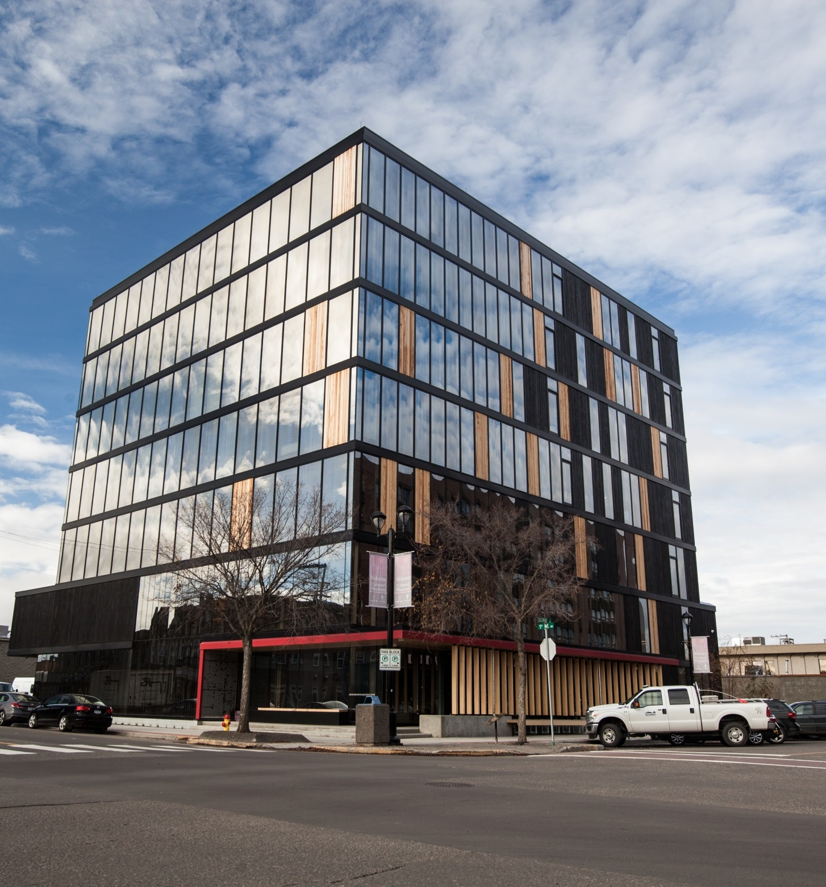
KEY PROJECT Innovative Construction
Wood Innovation and Design Centre
British Columbia, Canada
Architect: Michael Green Architecture
Completed: 2014
Designed to achieve LEED Gold certification, wood was selected for this 96-foot-tall structure to minimize the use of concrete and thus weight, and to speed construction.
Photo courtesy of naturally:wood
Notes:
24.
The 96-foot-tall Wood Innovation and Design Center (WIDC) was designed to achieve LEED Gold certification, it includes eight levels—six ‘stories’ as defined in the building code plus a penthouse and mezzanine.
The concept is a “dry construction” design, which virtually eliminates the use of concrete above grade except at the penthouse level. This allows the wood structure to be exposed as the ceiling finish; it also makes it easier to disassemble the building at the end of its functional service life, allowing re-use of the wood products.
The project consists of an innovative combination of glulam post and beam construction and built-up CLT floor panels. The beams frame into the columns using proprietary aluminum dovetail connectors, which allow the columns to run continuously from foundation to roof. The all-wood floor system spans nearly 20 feet between the post and beam frames.
The innovative system consists of overlapping three-ply upper CLT panels on five-ply or seven-ply lower CLT panels; the upper and lower panels are connected with adhesives and mesh connectors, providing a fully composite corrugated structural section. Cavities created within this section accommodate services above and below the floor structure.

Slide 25
TALL WOOD AROUND THE WORLD: LESSONS LEARNED
SECTION 3
Notes:
25.
SECTION 3: Tall Wood Around the World: Lessons Learned
Findings of Survey of International Tall Wood Buildings
Lessons Learned from Successful Tall Wood Projects

Slide 26
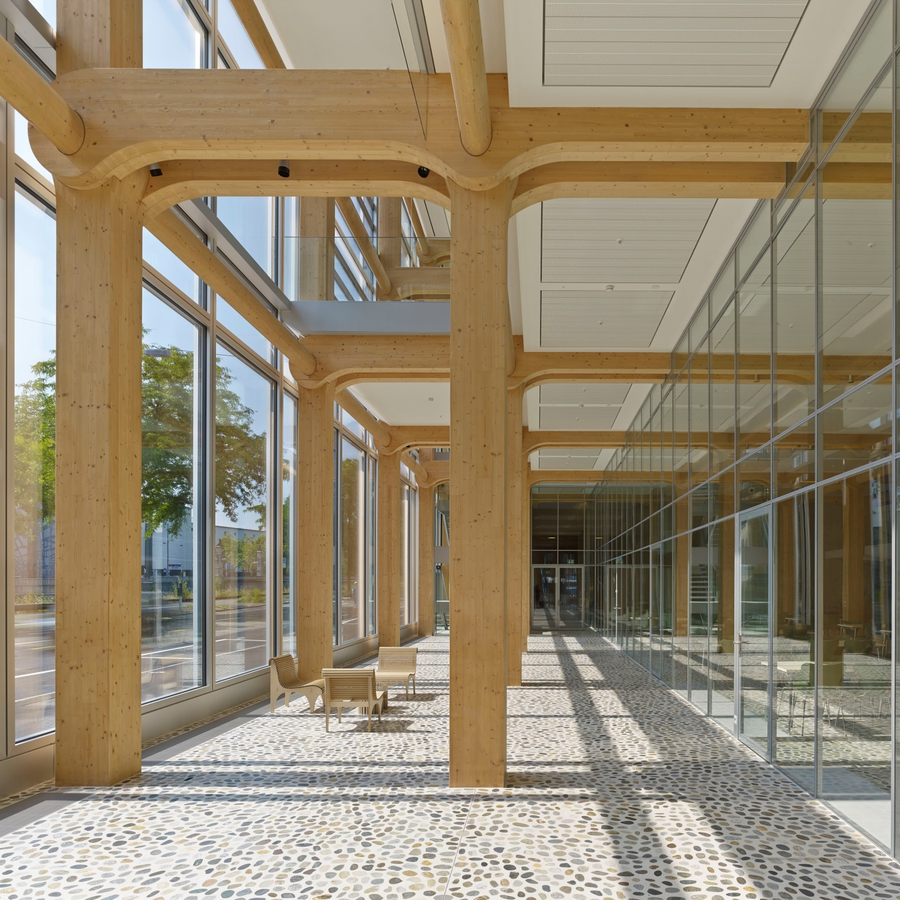
Design Versatility
For the six-story Tamedia, a post-and-beam structure was used to achieve large spans and open floor areas that can be easily customized and changed.
Photo courtesy of Didier Boy de la Tour
Photo courtesy of Didier Boy de la Tour
Notes:
26.

Slide 27
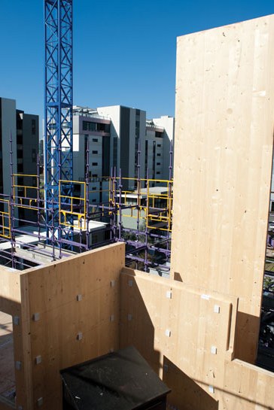
Findings of Survey of International Tall Wood Buildings
European construction practices support use of low-carbon, energy-efficient materials made from renewable resources
Strong collaboration among building team
Little deviation from conventional construction requirements regarding financing and insurance costs
Photo courtesy of Lend Lease
Notes:
27.
For the Survey of International Tall Wood Buildings, architecture firm Perkins+Will examined 10 tall wood building projects in several countries. Results revealed some important distinctions about building construction practices.
Europe has a strong regulatory grounding that supports the use of low-carbon materials, renewable resources, and energy efficiency in construction. These policies directly and indirectly encourage tall wood and mass timber construction.
They also found significant blending of professional roles across related sectors, creating a strong ethos of collaboration between developers, designers, timber fabricators, and researchers.
Experiences regarding financing and insurance costs or conditions suggest very little deviation from typical requirements for conventional tall reinforced concrete or steel.
In all cases, stakeholders reported they managed to overcome any approval, design, or construction obstacles without exceeding the projected budgets. No owner/developer indicated any irregularities regarding building operations or performance.

Slide 28
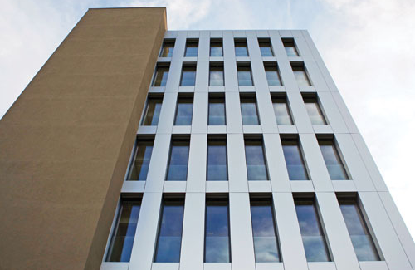
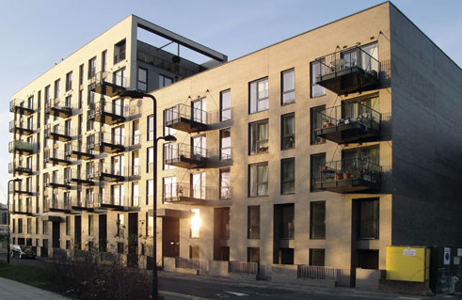
Lessons Learned from Successful Tall Wood Projects
Commit to a timber solution upfront
Pre-plan early in the design development process
Collaborate with entire team
Innovate holistically, rather than on single applications or components
Photo courtesy of Cree Buildings, Inc.
Photo courtesy of Karakusevic Carson Architects
Notes:
28.
Among the lessons learned from the Survey of International Tall Wood Buildings:
Commitment – All stakeholders stressed the importance of committing to a timber solution at the start of a project.
Planning – All stakeholders indicated the importance of pre-planning and investing significant effort early in the design development process to identify and resolve issues and conflicts.
Collaboration – Stakeholder groups were directly linked to or had strong collaborative ties with each other, researchers, and timber fabricators. In several cases, engaging early with the authority having jurisdiction and directly involving that person in the development process was key to gaining approvals for fire protection and acoustic performance.
Holistic innovation – Most stakeholders emphasized the need to approach mass timber/tall wood projects as wholly innovative rather than with a focus on just an application, a component, or a system that is related to wood elements.

Slide 29
RESPONSIBLE REVOLUTION
SECTION 4
Notes:
29.
SECTION 4: Responsible Revolution
Tall Wood Opportunities

Slide 30
Tall Wood Building
Opportunities
A lower carbon footprint
Meets safety and performance standards
Versatility of design:
All-wood
Hybrid
Building code developments promise future innovation
Notes:
30.
Tall wood buildings are capturing the imagination of architects, engineers and developers, who see them as a way to lessen the carbon footprint of the built environment while demonstrating ingenuity and meeting the same standards for safety and performance as any building type.
Although relatively new as a building category, examples of tall wood buildings to date are noteworthy for (among other things) their variation in design, from all-wood buildings made from CLT or a combination of dimension lumber and engineered wood products, to hybrid buildings of wood and other materials.
Among the many accelerating aspects of the tall wood revolution—such as seismic and other testing that will form the basis of further building code developments—innovations in approach will be one of the most exciting to watch as some of North America’s most creative minds embrace the challenge of designing tall wood buildings.

Slide 31
APPENDIX | COMMON MASS TIMBER PRODUCTS
SECTION 5
Notes:
31.
APPENDIX
Common Mass Timber Products
Mass timber building
Cross Laminated Timber (CLT)
Laminated Veneer Lumber (LVL)
Laminated Strand Lumber (LSL)
Glued-Laminated Timber (Glulam)
Why wood?

Slide 32
Mass Timber Building
Mass timber uses large prefabricated wood members for walls, floors and roofs or for beams and columns
Engineered for strength and dimensional stability
Quick installation
Up to 30 stories
Mid-rise, industrial, educational and other building types
Notes:
32.
Midrise (six to 12 stories) and tall buildings (up to 30 stories) could be safely, efficiently, and economically built using mass timber construction techniques. Mass timber construction uses large prefabricated wood members such as CLT, laminated veneer lumber (LVL), and laminated strand lumber (LSL) for wall, floor, and roof construction. Glulam can also be used in column and beam applications.

Slide 33
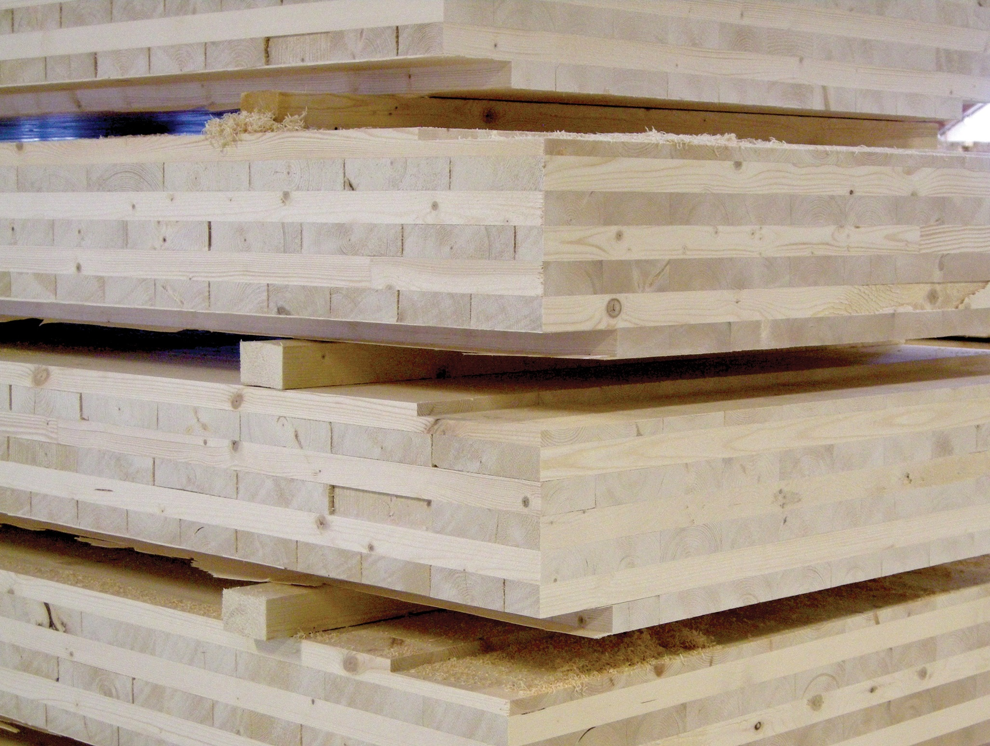
Cross Laminated Timber (CLT)
Engineered wood panel
3, 5 or 7 layers of dimension lumber oriented at right angles to one another then glued to form structural panels
Exceptionally strong, dimensionally stable and rigid
Panels resist high racking and compressive forces
Cost effective for multi-story and long-span diaphragm applications
Photo courtesy of FPInnovations
Notes:
33.
Cross Laminated Timber (CLT) is an engineered wood panel typically consisting of three, five, or seven layers of dimension lumber oriented at right angles to one another and then glued to form structural panels with exceptional strength, dimensional stability, and rigidity.
Since CLT panels resist high racking and compressive forces, they are particularly cost effective for multi-story and long-span diaphragm applications.

Slide 34
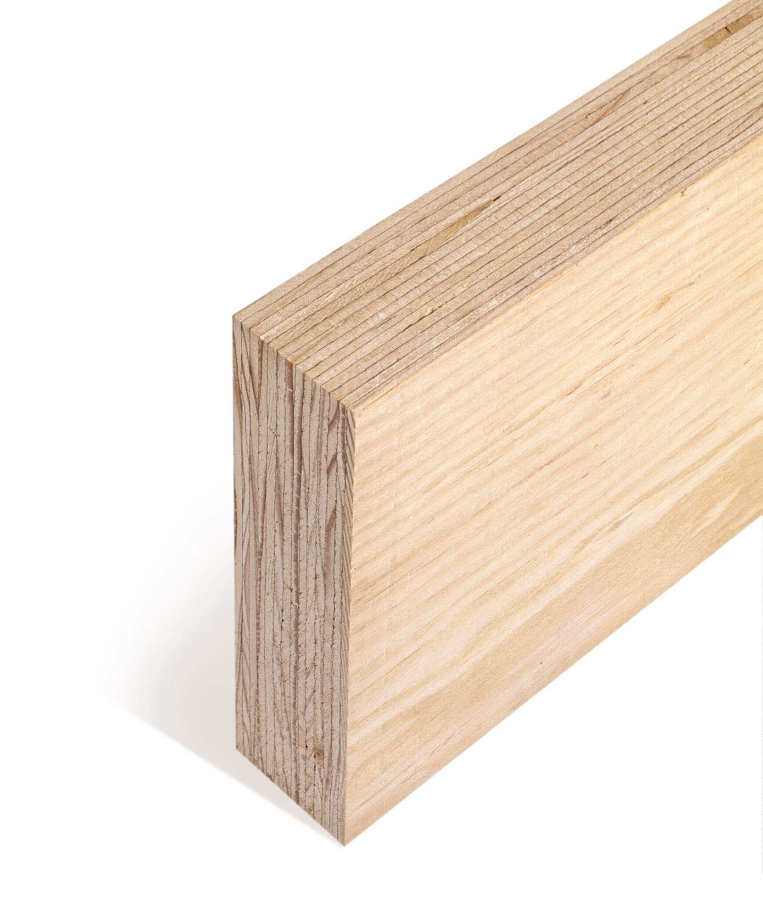
Laminated Veneer Lumber (LVL)
Thin wood veneers bonded together
Wood grain oriented parallel to the length of the member
Predictable structural performance and dimensional stability
Free from warping and splitting
Can be manufactured in a broad range of widths, depths and lengths
Photo courtesy of APA—The Engineered Wood Association
Notes:
34.
Laminated Veneer Lumber (LVL) is produced by bonding thin wood veneers together using waterproof adhesives under heat and pressure and then sawn to desired dimensions. The wood grain of the veneers is oriented parallel to the length of the member. Since it is manufactured with kiln-dried wood veneers and because each veneer layer is oriented in the same direction, LVL has predictable structural performance and dimensional stability, being virtually free from warping and splitting. LVL can be manufactured in a broad range of widths, depths, and lengths.

Slide 35
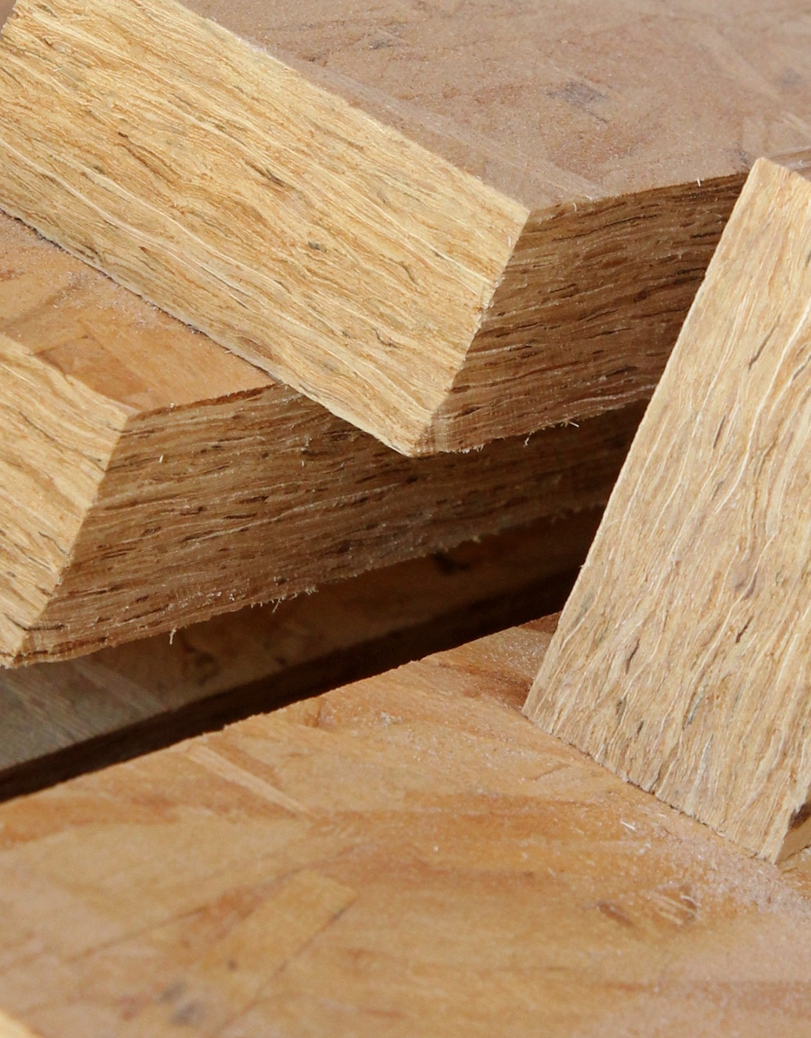
Laminated Strand Lumber (LSL)
Engineered structural composite lumber
Thin chips or strands of wood up to 6” in length glued under pressure
Wood grain oriented parallel to the length of the member, then machined to finished sizes
Strong when face- or edge-loaded
Photo courtesy of APA—The Engineered Wood Association
Notes:
35.
Laminated Strand Lumber (LSL) is also an engineered structural composite lumber product manufactured by aligning thin chips or strands of wood up to 6 inches in length and gluing them under pressure. Like LVL, the wood grain of the strands is oriented parallel to the length of the member, and the wood member is then machined to consistent finished sizes. Common LSL sizes range up to 8 feet wide and 64 feet long. It is strong when either face- or edge-loaded, but typically has lower strength and stiffness properties than LVL.

Slide 36
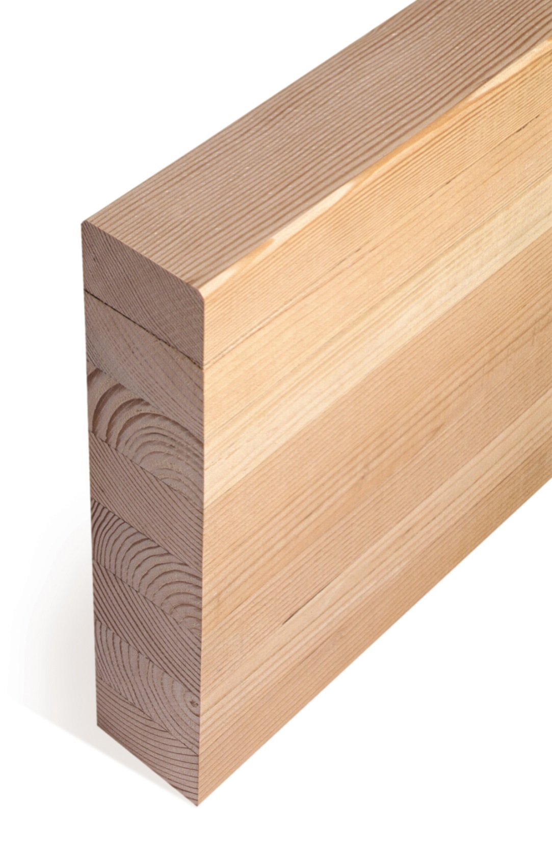
Glued-Laminated Timber (Glulam)
Composed of individual wood laminations
Bonded together with durable, moisture-resistant adhesives
Grain runs parallel with length of member
Used horizontally as a beam or vertically as a column
Suitable for both structural and architectural applications
Photo courtesy of APA—The Engineered Wood Association
Notes:
36.
Glued-Laminated Timber (Glulam) is composed of individual wood laminations (dimension lumber), specifically selected and positioned based on their performance characteristics, and then bonded together with durable, moisture-resistant adhesives. The grain of all laminations runs parallel with the length of the member. Glulam can be used in horizontal applications as a beam, or vertically as a column. Glulam is available in depths from 6 to 72 inches or greater and in lengths up to 100 feet and longer. Glulam has excellent strength and stiffness properties (pound for pound, it is stronger than steel), and is available in a range of appearance grades for structural or architectural applications.

Slide 37
endnotes
SECTION 6
Notes:
37.
Sources
The Case for Tall Wood Buildings: How Mass Timber Offers a Safe, Economical, and Environmentally Friendly Alternative for Tall Building Structures, 2013, Michael Green Architecture/Equilibrium Consulting
Summary Report: Survey of International Tall Wood Buildings, 2014, Binational Softwood Lumber Council, Forestry Innovation Investment
Synthesis of Research on Wood Products & Greenhouse Gas Impacts, 2nd Edition – R. Sarthe, J. O’Connor, FPInnovations, 2010; Wooden building products in comparative LCA: A literature review – International Journal of Life Cycle Assessment, 12(7): 470-479, F. Werner, K. Richter, 2007
Examples can be found in the continuing education course, Rethinking Wood as a Material of Choice, www.rethinkwood.com/sites/default/files/FII_CEU_AR_Rethinking_Choice.pdf
Forté Case Study, Lend Lease, 2012
Calculating the Fire Resistance of Exposed Wood Members, Technical Report 10, American Wood Council, 2003
Wood-Concrete Hybrid Construction, Canada Wood
U.S. CLT Handbook, FPInnovations, 2013
Bridport House Case Study, Willmott Dixon, 2011
Structural Composite Lumber (SCL): A Practical Alternative, APA – The Engineered Wood Association, 2012
Glulam: Visible Beauty, Hidden Strength, APA – The Engineered Wood Association, 2012

Slide 38
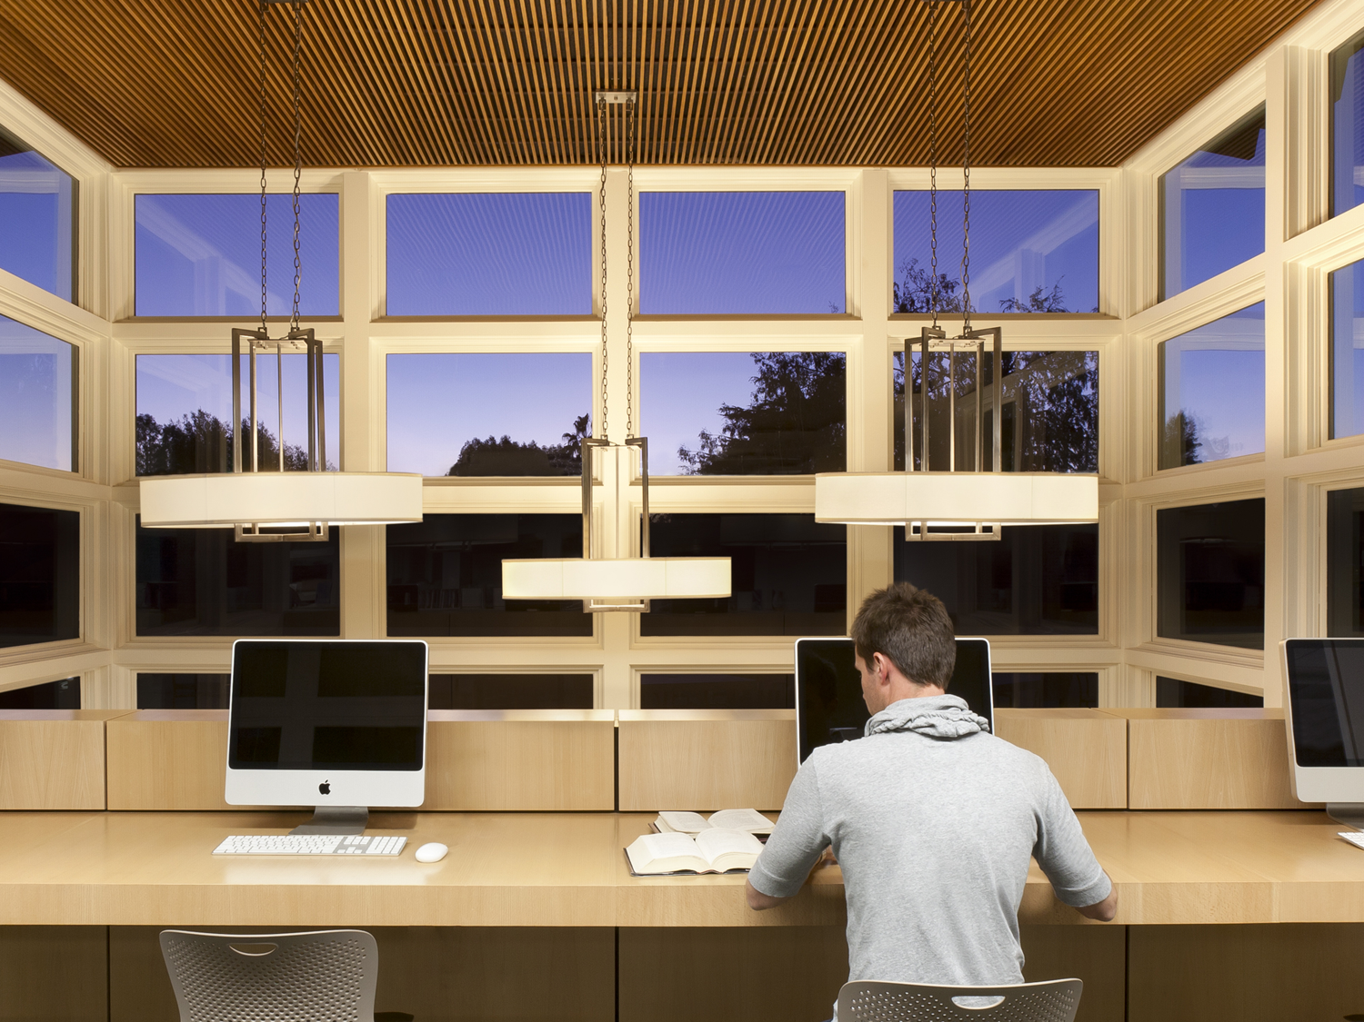
Ready to take the online CEU Test?
Click below to earn your AIA/CES HSW Learning Unit:
http://continuingeducation.construction.com/reThinkWood.php
Photo by David Lena; courtesy of HMC Architects
Notes:
38.
Click on the button above, or go to: http://continuingeducation.construction.com/reThinkWood.php

Slide 39
THANK YOU!
For more information on building with wood, visit reThinkWood.com/CEU
Notes:
39.
Thank you for your time. Visit www.reThinkWood.com/CEU for more information, or email info@reThinkWood.com with any questions.

